Slide 1
Vent-A-Riser
Overview
When a pump trips, a vacuum occurs as water is drawn from the riser.
On pump restart, the void is rapidly filled resulting in very high pressure transients when the water column slams against the top of the riser which can result in pipe rupture.
A Vent-A-Riser installed at the top of each riser fulfils the following functions:
Provide vacuum protection when the pump stops and the vertical column drains.
Provide effective and controlled release of air in the vertical riser upon pump startup.
Notes:
CATT is a grand title to describe the design philosophy of the vent-O-Mat range.
Presentation seeks to demistify the black art of selecting and sizing air valves.
If carried out correctly, air valves will allow the pipeline to operate at the designed value over its operational lifetime.

Slide 2
Vent-A-Riser
Operation
High capacity Air intake to meet maximum demand
Slow to
Exhaust to limit high discharge velocities
TOP FLOOR
TOP FLOOR
Notes:
CATT is a grand title to describe the design philosophy of the vent-O-Mat range.
Presentation seeks to demistify the black art of selecting and sizing air valves.
If carried out correctly, air valves will allow the pipeline to operate at the designed value over its operational lifetime.

Slide 3
Vent-A-Riser
Installation
The valve must be installed at the top of each riser to ensure adequate Water-Hammer protection. A suitable isolating valve should also be installed to facilitate maintenance.
To ensure proper operation the pipeline must be adequately flushed prior to installation.
Valve must be mounted directly to ‘T’ connection supplying the final branch of the riser.
A 1” male outlet connection allows any released water to be discharged externally to the building or to drain with a suitable air gap via a tundish.
Refer to WRAS IRN R535 note for installation guidance.
Install at elevations > 10 meters higher than pumpset
Notes:
CATT is a grand title to describe the design philosophy of the vent-O-Mat range.
Presentation seeks to demistify the black art of selecting and sizing air valves.
If carried out correctly, air valves will allow the pipeline to operate at the designed value over its operational lifetime.

Slide 4
Vent-A-Riser
Installation – Do’s and Don’ts
Drain pipe must be equal or larger than valve connection
Ensure drain pipe is sloping down towards tundish to avoid stagnation
Ensure free intake of clean air
Option to:
Exhaust connection to outside building
Drain via tundish
Install as close to the ‘T’ connection (last point of demand) as possible to avoid stagnation
Locate pipework below the level of the surge arrestor to minimise the risk of water spill following pump trip
Notes:
Floats lose buoyancy at 0.3 bar. As system drains, risk of static pressure above the valve leaking

Slide 5
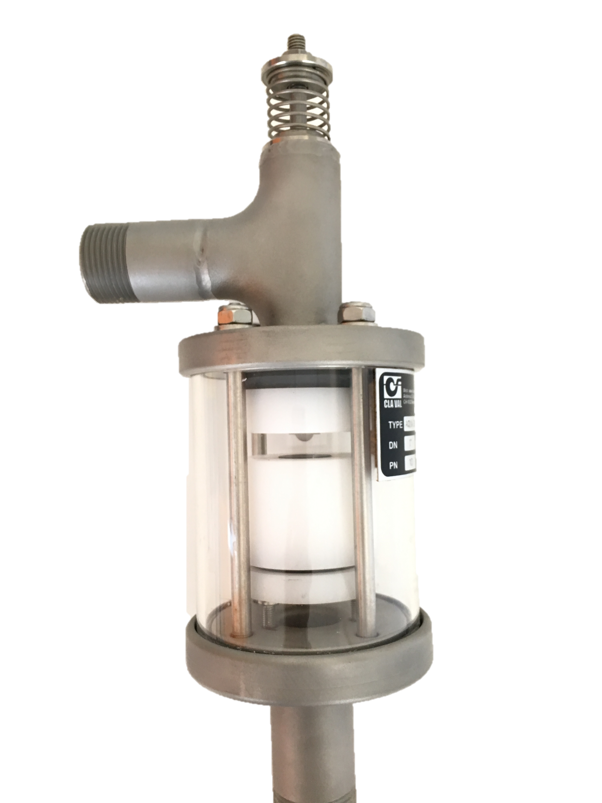
Vent-A-Riser
Technical Info
1” diameter air intake
Materials:
  Body: Grade 304 Stainless Steel
  Floats: HDPE; Rubber parts: EPDM
Minimum operating pressure 0.3 Bar g
Maximum operating pressure 10 Bar g
Maximum surge pressure 40 Bar g
Operating temperatures 2°c - 60°c
Air intake capacity at -0.1 bar g / -10kPa
49 Normal l/sec 176 m3/h
End connection 1” BSP Female
Weight (including ‘Y’ Strainer) 3.5 Kg
Non compressible HPDE floats
Notes:
CATT is a grand title to describe the design philosophy of the vent-O-Mat range.
Presentation seeks to demistify the black art of selecting and sizing air valves.
If carried out correctly, air valves will allow the pipeline to operate at the designed value over its operational lifetime.

Slide 6
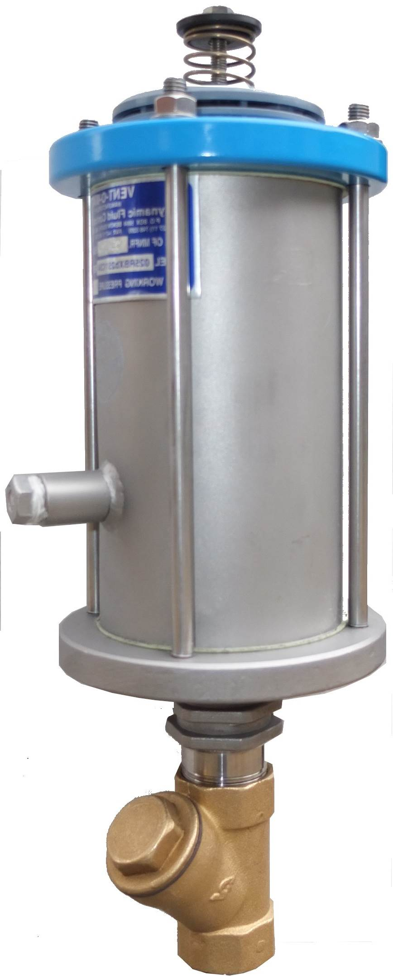
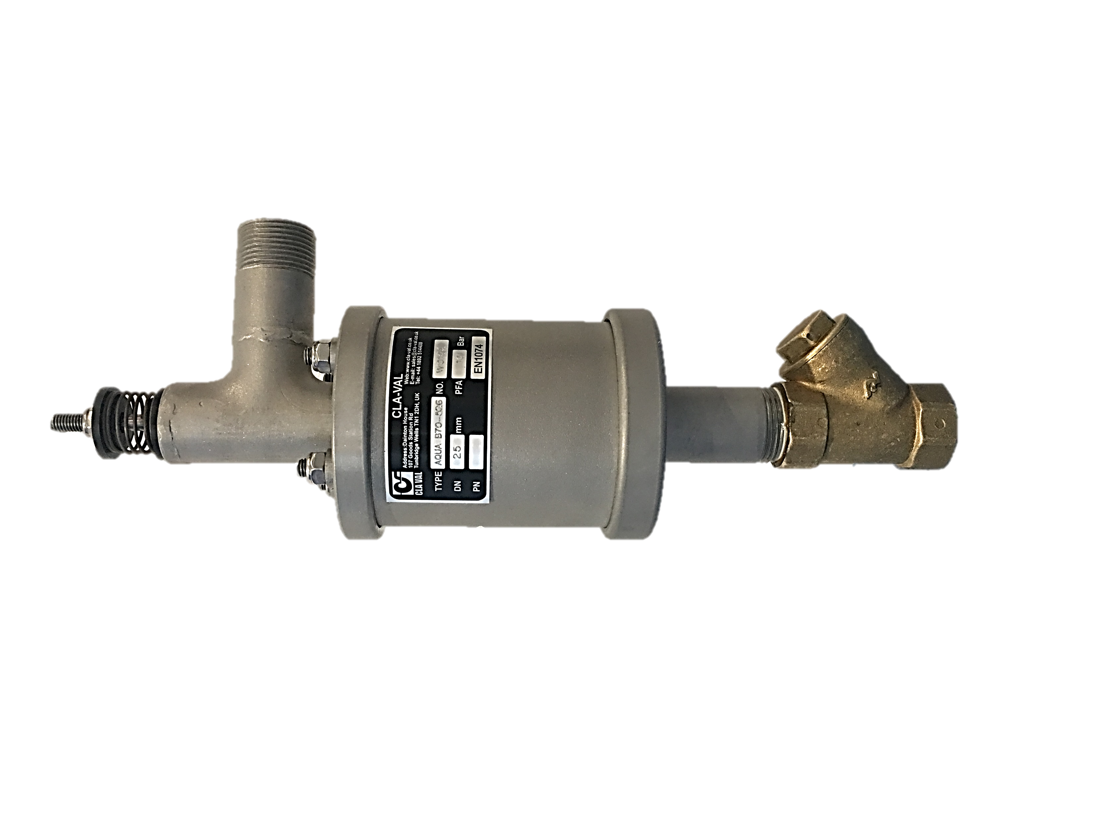
Vent-A-Riser vs Vent-O-Mat
Comparison
Adequate flushing through the ball valve prior to the installation of the RBXb2511-GP is therefore highly recommended.
Differences | Cla-Val Vent-A-Riser | Vent-O-Mat RBXb211
Outlet connection | Threaded Outlet – Drain | Vented Grill
Minimum operating pressure | 0.3 bar | 0.5 bar
Maximum operating pressure | 10 bar (40 bar surge pressure) | 25 bar
Materials of construction | All Stainless steel with HPDE floats and EPDM rubber parts | Fusion bonded epoxy coated mild steel and Stainless steel, with HPDE floats and EPDM rubber parts
Weight | 3.5 kg | 5 kg
Warranty Period | 3 years | 1 year
Common functions:
Dampens effect of Water-Hammer at pump startup.
Provides full vacuum protection when the pump stops and the riser drains.
Pressurised air discharge during normal operation
Notes:
CATT is a grand title to describe the design philosophy of the vent-O-Mat range.
Presentation seeks to demistify the black art of selecting and sizing air valves.
If carried out correctly, air valves will allow the pipeline to operate at the designed value over its operational lifetime.

Slide 7
Vent-A-Riser vs Vent-O-Mat
Comparison
Gyproc ceiling
Minimal risk with Tee outlet
Susceptible to ceiling debris and dust being ingested through the grills
Notes:
CATT is a grand title to describe the design philosophy of the vent-O-Mat range.
Presentation seeks to demistify the black art of selecting and sizing air valves.
If carried out correctly, air valves will allow the pipeline to operate at the designed value over its operational lifetime.

Slide 8
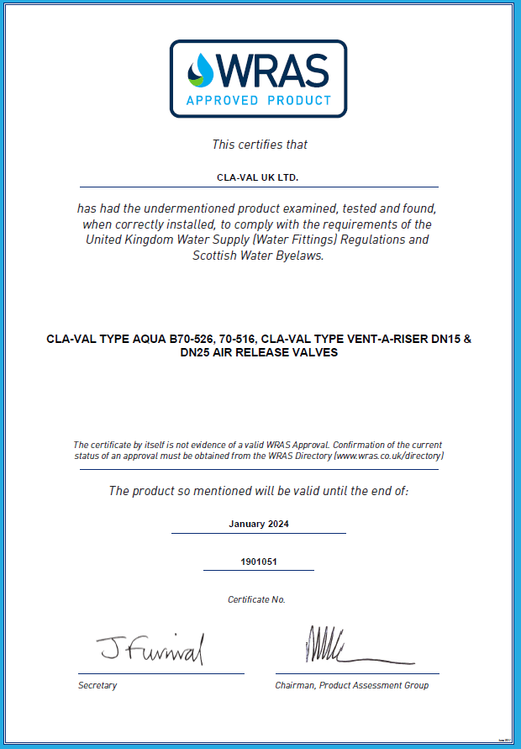
Vent-A-Riser
Compliance
Notes:
CATT is a grand title to describe the design philosophy of the vent-O-Mat range.
Presentation seeks to demistify the black art of selecting and sizing air valves.
If carried out correctly, air valves will allow the pipeline to operate at the designed value over its operational lifetime.

